Slide 1
Human Resource Management
Module 2
Prepared by
Sriram K
Department of Mechanical Engineering
School of Engineering , CUSAT

Slide 2
Human Resource Management
The study of activities regarding people working in an organization
It is a managerial function that tries to match an organization’s needs to the skills and abilities of its employees.
It is an administrative , operational and strategic process

Slide 3
Definition of HRM
HRM is a management function concerned with hiring, motivating and maintaining people in an organization.
HRM is designing management systems to ensure that human talent is used effectively and efficiently to accomplish organizational goals.
The art of procuring, developing and maintaining competent workforce to achieve the goals of an organization in an effective and efficient manner.

Slide 4
Major functioning of HRM
procurement,
development,
compensation,
integration
maintenance of the personnel of an organization

Slide 5
The Core of HRM
The following constitute the core of HRM
1. HRM Involves the Application of Management Functions and Principles.
The functions and principles are applied to acquiring, developing, maintaining and providing remuneration to employees in organization.

Slide 6
The Core of HRM
2. Decision Relating to Employees must be Integrated.
Decisions on different aspects of employees must be consistent with other human resource (HR) decisions.
3. Decisions Made Influence the Effectiveness of an Organization.
Effectiveness of an organization will result in betterment of services to customers in the form of high quality products supplied at reasonable costs.

Slide 7
The Core of HRM
4. HRM Functions are not Confined to Business Establishments Only but applicable to non business organizations such as education, health care, recreation and like.

Slide 8
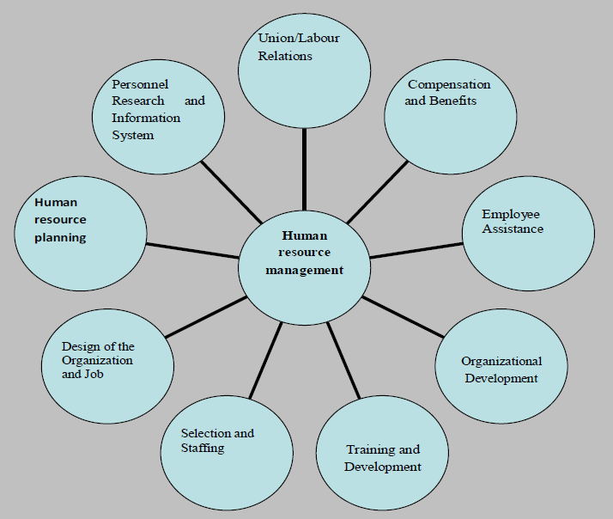
Characteristics of HRM
American Society for Training and Development (ASTD) conducted fairly an exhaustive study in this field and identified nine broad areas of activities of HRM.

Slide 9
Human Resource Planning:
the right types of persons at the right time at the right place
It prepares human resources inventory with a view to assess present and future needs, availability and possible shortages in human resource
HR Planning forecast demand and supplies and identify sources of selection

Slide 10
2) Design of Organization and Job:
This is the task of laying down organization structure, authority, relationship and responsibilities.
Defining the work content for each position (known as job description)
Job specification identifies the attributes of persons who will be most suitable for each job which is defined by job description.

Slide 11
3) Selection and Staffing:
the process of recruitment and selection of staff.
It involves matching people and their expectations with which the job specifications and career path available within the organization.
4) Training and Development:
It is an organized attempt to find out training needs of the individuals to meet the knowledge and skill which is needed not only to perform current job but also to fulfil the future needs of the organization.

Slide 12
5) Organizational Development:
To maintain an healthy interpersonal and inter-group relationship within the organization.
6) Compensation and Benefits:
The wages and compensations are fixed scientifically to meet fairness and equity criteria.
In addition labour welfare measures are involved which include benefits and services.

Slide 13
7) Employee Assistance:
The individuality of employees to be considered and the assistance to their personal as well as official problems for better productivity
8) Union-Labour Relations:
Healthy Industrial and Labour relations are very important for enhancing peace and productivity in an organization.

Slide 14
9) Personnel Research and Information System:
Knowledge on behavioural science and industrial psychology throws better insight into the workers expectations, aspirations and behaviour.
Advancement of technology of product and production methods have created new working environment
Science of ergonomics gives better ideas of doing a work more conveniently by an employee.
It must also take special care for improving exchange of information through effective communication systems on a continuous basis especially on moral and motivation.

Slide 15
Objectives of HRM
The primary objective of HRM is to ensure the availability of competent and willing workforce to an organization.
Specific objectives
1) Human capital : assisting the organization in obtaining the right number and types of employees to fulfil its strategic and operational goals
2) Developing organizational climate: helping to create a climate in which employees are encouraged to develop and utilize their skills to the fullest and to employ the skills and abilities of the workforce

Slide 16
Objectives of HRM
3) Helping to maintain performance standards and increase productivity through effective job design; providing adequate orientation, training and development; providing performance-related feedback; and ensuring effective two-way communication.
4) Helping to establish and maintain a harmonious employer/employee relationship
5) Helping to create and maintain a safe and healthy work environment

Slide 17
Objectives of HRM
6) Developing programs to meet the economic, psychological, and social needs of the employees and helping the organization to retain the productive employees
7) Ensuring that the organization is in compliance with provincial/territorial and federal laws affecting the workplace (such as human rights, employment equity, occupational health and safety, employment standards, and labour relations legislation). To help the organization to reach its goals

Slide 18
Objectives of HRM
8) To provide organization with well-trained and well-motivated employees
9) To increase the employees satisfaction and self-actualization
10) To develop and maintain the quality of work life
11) To communicate HR policies to all employees.
12) To help maintain ethical polices and behaviour.

Slide 19
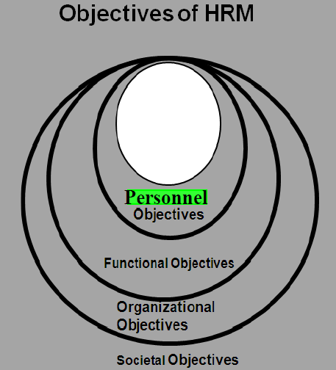
Objectives of HRM
All above mentioned objectives are categorized under four specific objectives:
societal,
organizational,
functional
personnel.

Slide 20
1) Societal Objectives:
seek to ensure that the organization becomes socially responsible to the needs and challenges of the society while minimizing the negative impact of such demands upon the organization.
The failure of the organizations to use their resources for the society’s benefit in ethical ways may lead to restriction.
2) Organizational Objectives:
It recognizes the role of HRM in bringing about organizational effectiveness.
It makes sure that HRM is not a standalone department, but rather a means to assist the organization with its primary objectives.
The HR department exists to serve the rest of the organization.

Slide 21
3) Functional Objectives:
Human resources are to be adjusted to suit the organization’s demands in an efficient method
4) Personnel Objectives:
it is to assist employees in achieving their personal goals, at least as far as these goals enhance the individual’s contribution to the organization.
Personal objectives of employees must be met if they are to be maintained, retained and motivated.
Otherwise employee performance and satisfaction may decline giving rise to employee turnover.

Slide 22
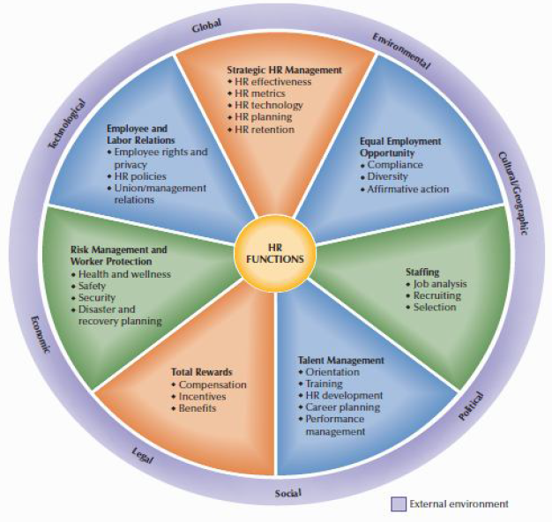
Functions of HRM
Seven major functions
Additional Functions
legal,
economic,
technological,
global,
environmental,
cultural/geographic,
political,
social

Slide 23
Strategic HR Management:
HR effectiveness can be increased through the use of HR metrics and HR technology
Human resource planning (HRP) function determine the number and type of employees needed to accomplish organizational goals.
HRP includes creating venture teams with a balanced skill-mix, recruiting the right people, and voluntary team assignment.
The basic HRP strategy is staffing and employee development.

Slide 24
2) Equal Employment Opportunity:
Compliance with equal employment opportunity (EEO) laws and regulations affects all other HR activities.
3) Staffing:
to provide a sufficient supply of qualified individuals to fill jobs in an organization
Job analysis, recruitment and selection are the main functions under staffing.
Job analysis is the process of describing the nature of a job and specifying the human requirements such as knowledge, skills, and experience needed to perform the job
Job description spells out work duties and activities of employees.

Slide 25
HRP precedes the actual selection of people for organization.
4) Talent Management and Development:
Orientation is the first step towards helping a new employee to adjust himself to the new job and the employer including pay and benefit programmes, working hours and company rules and expectations
Training and Development programs provide useful means of assuring that the employees are capable of performing their jobs at acceptable levels and also more than that
on the job and off the job training programmes

Slide 26
5) Total Rewards:
Compensation in the form of pay, incentives and benefits are the rewards given to the employees for performing organizational work
To be competitive, employers may use variable pay programs such as incentive rewards, promotion from within the team, recognition rewards, balancing team and individual rewards etc.
Benefits are another form of compensation to employees other than direct pay for the work performed. Benefits include both legally required items and those offered at employer’s discretion.

Slide 27
6) Risk Management and Worker Protection:
HRM addresses various workplace risks to
ensure protection of workers by meeting legal requirements and being more responsive to concerns for workplace health and safety along with disaster and recovery planning.
7) Employee and Labor Relations:
The relationship between managers and their employees must be handled legally and effectively.
It is important to develop, communicate, and update HR policies and procedures so that managers and employees alike know what is expected
The term labour relation refers to the interaction with employees who are represented by a trade union

Slide 28
Unions are organization of employees who join together to obtain more voice in decisions affecting wages, benefits, working conditions and other aspects of employment.
With regard to labour relations the major function of HR personnel includes negotiating with the unions regarding wages, service conditions and resolving disputes and grievances.

Slide 29
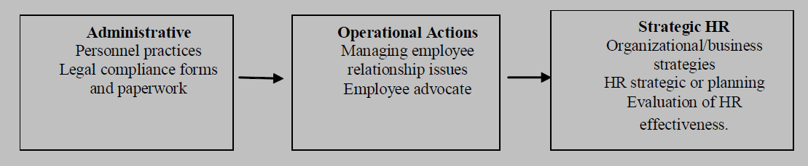
ROLL OF HRM

Slide 30
1-Administrative roll:
administration and recordkeeping including essential legal paperwork and policy implementation.
Two major shifts driving the transformation of the administrative role are: Greater use of technology and Outsourcing.
Technology is being used in most HR activities, from employment applications and employee benefits enrolments to e-learning using Internet-based resources

Slide 31
2. Operational and Employee Advocate Role for HR
HR often has been viewed as the “employee advocate” in organizations.
They act as the voice for employee concerns, and spend considerable time on HR “crisis management,” dealing with employee problems that are both work-related and not work-related.
Employee advocacy helps to ensure fair and equitable treatment for employees regardless of personal background or circumstances

Slide 32
The operational role requires HR professionals to cooperate with various departmental and operating managers and supervisors in order to identify and implement needed programs and policies in the organization.
Operational activities are tactical in nature.

Slide 33
3) Strategic roll of HRM
It means that HR professionals are proactive in addressing business realities and focusing on future business needs, such as strategic planning, compensation strategies, the performance of HR, and measuring its results.
HR should be responsible for knowing what the true cost of human capital is for an employer
HR is involved in devising strategy in addition to implementing strategy.

Slide 34
Some areas where HR involves in strategic planning
Evaluating mergers and acquisitions for organizational “compatibility,” structural changes, and staffing needs
Conducting workforce planning to anticipate the retirement of employees at all levels and identify workforce expansion in organizational strategic plans
Leading site selection efforts for new facilities or transferring operations to international outsourcing
locations based on workforce needs
Instituting HR management systems to reduce administrative time, equipment, and staff by using HR technology
Working with executives to develop a revised sales
compensation and incentives plan as new products

Slide 35
Recruitment
It forms a step in the process which continues with selection and ceases with the placement of the candidate.
It follows the step man power planning
It makes it possible to acquire the number and types of people necessary to ensure the continued operation of the organisation
It is the discovering of potential applicants for actual or anticipated organisational vacancies
Recruiting is a process to discover the sources of manpower to meet the requirements of the staffing schedule and to employ effective measures for attracting that manpower in adequate numbers to facilitate effective selection of an efficient working force

Slide 36
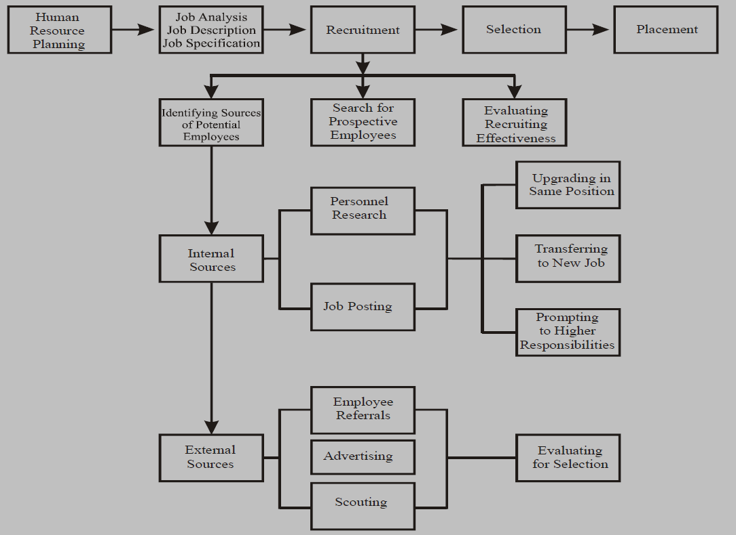
Place of Recruitment in Selection System

Slide 37
The need for recruitment arises out of the following situations:
Vacancies created due to expansion, diversification, and growth of business.
An increase in the competitive advantage of certain concerns, enabling them to get more of the available business than formerly.
An increase in business arising from an upswing during the recovery period of a business cycle.
Vacancies created due to transfer, promotion, retirement, termination, permanent disability or death.
The normal population growth, which requires increased goods and services to meet the needs of the people.
A rising standard of living, which requires more of the same goods and services as well as the creation of new wants to be satisfied.

Slide 38
Process of Recruitment
Recruitment process begins when the personnel department receives requisitions for recruitment from any department of the company
the position to be filled, number of persons to be recruited, the duties to be performed, qualifications expected from the candidates, terms and conditions of employment and the time by which the persons should be available for appointment
Locating and developing the sources of required number and type of employees
Identifying the prospective employees with required characteristics.

Slide 39
Developing the techniques to attract the desired candidates.
The goodwill of an organisation in the market may be one technique.
The publicity about the company being a good employer may also help in stimulating candidates to apply.
There may be others of attractive salaries, proper facilities for development etc.
Evaluating the effectiveness of recruitment process.

Slide 40
Elements of Recruitment
personnel recruitment process involves five elements, viz.,
a recruitment policy,
a recruitment organisation,
a forecast of manpower,
the development of sources of recruitment,
Different techniques used for utilising these sources, and a method of assessing the recruitment programme.

Slide 41
1.Recruitment Policy
It specifies the objectives of recruitment and provides a framework for the implementation of the recruitment programme.
It also involves the employer’s commitment to some principles as to find and employ the best qualified persons for each job, to retain the most promising of those hired, etc.
It should be based on the goals, needs and environment of the organisation.

Slide 42
Recruitment Policy
It may embrace several issues such as the extent of promotion from within, attitudes of enterprise in recruiting old, handicapped, and minor individuals, minority group members, part-time employees and relatives of present employees.
It may also involve the organisation system to be developed for implementing the recruitment programme and procedures to be employed

Slide 43
Recruitment Policy
Recruitment policy covers the following areas:
To prescribe the degree of emphasis. Inside the organisation or outside the organisation.
To provide the weightage that would be given to certain categories of people such as gender, local population, physically-handicapped personnel, etc.
To prescribe whether the recruitment would be centralised or decentralised at unit levels.
To specify the degree of flexibility with regard to age, qualifications, compensation structure and other service conditions.

Slide 44
To prescribe the personnel who would be involved in recruitment process and the role of human resource department in this regard.
To specify the budget for meeting the expenditures incurred in completing the recruitment process.

Slide 45
Factors are involved in a recruitment policy:
Generally, the following factors are involved in a recruitment policy:
To provide each employee with an open road and encouragement in the continuing development of his talents and skills;
To provide individual employees with the maximum of employment security, avoiding, frequent lay-off or lost time;
To avoid cliques which may develop when several members of the same household or community are employed in the organisation;

Slide 46
To carefully observe the letter and spirit of the relevant public policy on hiring and, on the whole, employment relationship;
To assure each employee of the organisation interest in his personal goals and employment objective;
To assure employees of fairness in all employment relationships, including promotions and transfers;
To provide employment in jobs which are engineered to meet the qualifications of handicapped workers and minority sections; and
To encourage one or more strong, effective, responsible trade unions among the employees.

Slide 47
Prerequisites of a Good Recruitment Policy: The recruitment policy of an organisation must satisfy the following conditions:
It should be in conformity with its general personnel policies;
It should be flexible enough to meet the changing needs of an organisation;
It should be so designed as to ensure employment opportunities for its employees on a long-term basis so that the goals of the organisation should be achievable; and it should develop the potentialities of employees;
It should match the qualities of employees with the requirements of the work for which they are employed; and
It should highlight the necessity of establishing job analysis.

Slide 48
2. Recruitment Organisation:
The recruitment may be centralised like public sector banks or decentralised.
Both practices have their own merits.
The choice between the two will depend on the managerial philosophy and the particular needs of the organisation.
3. Sources of Recruitment:
Various sources of recruitment may be classified as internal and external.
These have their own merits and demerits.

Slide 49
4. Methods of Recruitment:
Recruitment techniques are the means to make contact with potential candidates, to provide them necessary information and to encourage them to apply for jobs.
5. Evaluation of Recruitment Programme:
The recruitment process must be evaluated periodically.
The criteria for evaluation may consist of cost per applicant, the hiring ratio, performance appraisal, tenure of stay, etc.
After evaluation, necessary improvements should be made in the recruitment programme.

Slide 50
Factor Affecting Recruitment
The factors affecting recruitment can be classified as internal and external factors.
The internal factors are:
Wage and salary policies;
The age composition of existing working force;
Promotion and retirement policies;
Turnover rates;
The nature of operations involved the kind of personnel required;

Slide 51
The level and seasonality of operations in question;
Future expansion and reduction programmes;
Recruiting policy of the organisation;
Human resource planning strategy of the company;
Size of the organisation and the number of employees employed;
Cost involved in recruiting employees, and finally;
Growth and expansion plans of the organisation.

Slide 52
The external factors are:
Supply and demand of specific skills in the labour market;
Company’s image perception of the job seekers about the company.
External cultural factors: Obviously, the culture may exert considerable check on recruitment. For example, women may not be recruited in certain jobs in industry.
Economic factors: such as a tight or loose labour market, the reputation of the enterprise in the community as a good pay master or otherwise and such allied issues which determine the quality and quantity of manpower submitting itself for recruitment.
Political and legal factors also exert restraints in respect of nature and hours of work for women and children, and allied employment practices in the enterprise, reservation of Job for SC, ST and so on.

Slide 53
Sources of Recruitment
The identification of sources from which these candidates can be attracted.
Some companies try to develop new sources, while most only try to tackle the existing sources they have.
These sources, accordingly, may be termed as internal and external.

Slide 54
Internal Sources
Two categories of internal sources including a review of the present employees and nomination of candidates by employees.
Effective utilisation of internal sources necessitates an understanding of their skills and information regarding relationships of jobs
Possibilities for horizontal and vertical transfers within the enterprise
Internal sources can be used effectively if the numbers of vacancies are not very large, adequate, employee records are maintained, jobs do not demand originality lacking in the internal sources, and employees have prepared themselves for promotions

Slide 55
Merits of Internal Sources:
It creates a sense of security among employees when they are assured that they would be preferred in filling up vacancies.
It improves the morale of employees, for they are assured of the fact that they would be preferred over outsiders when vacancies occur.
It promotes loyalty and commitment among employees due to sense of job security and opportunities for advancement.
The employer is in a better position to evaluate those presently employed than outside candidates. This is because the company maintains a record of the progress, experience and service of its employees.
Time and costs of training will be low because employees remain familiar with the organisation and its policies.

Slide 56
Relations with trade unions remain good. Labour turnover is reduced.
It encourages self-development among the employees. It encourages good individuals who are ambitious.
It encourages stability from continuity of employment.
It can also act as a training device for developing middle and top-level managers.

Slide 57
Demerits of Internal Sources
There are possibilities that internal sources may “dry up”, and it may be difficult to find the requisite personnel from within an organisation.
It often leads to inbreeding, and discourages new blood from entering and organisation.
As promotion is based on seniority, the danger is that really capable hands may not be chosen.
The likes and dislikes of the management may also play an important role in the selection of personnel.
Since the learner does not know more than the lecturer, no innovations worth the name can be made. Therefore, on jobs which require original thinking (such as advertising, style, designing and basic research), this practice is not followed.

Slide 58
External Sources
Employment agencies.
Public and private employment agencies
Educational and technical institutes.
provides a constant flow of new personnel with leadership potentialities.
on-campus interview
Casual labour or “applicants at the gate”
The candidates may appear personally at the company’s employment office or send their applications for possible vacancies

Slide 59
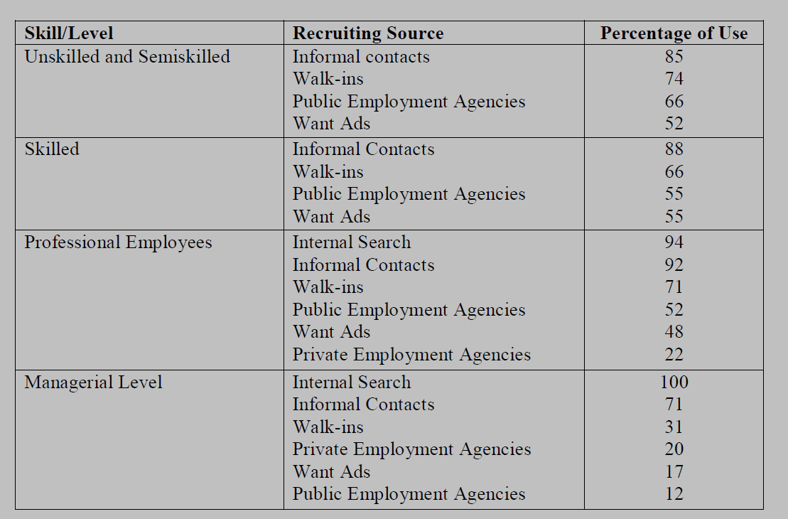
Example of Recruitments

Slide 60
Advantages of External Recruitment:
It will help in bringing new ideas, better techniques and improved methods to the organisation.
The cost of employees will be minimised because candidates selected in this method will be placed in the minimum pay scale.
The existing employees will also broaden their personality.
The entry of qualitative persons from outside will be in the interest of the organisation in the long run.
The suitable candidates with skill, talent, knowledge are available from external sources.
The entry of new persons with varied expansion and talent will help in human resource mix.

Slide 61
Disadvantages of External recruitments
Orientation and training are required as the employees remain unfamiliar with the organisation.
It is more expensive and time-consuming. Detailed screening is necessary as very little is known about the candidate.
If new entrant fails to adjust himself to the working in the enterprise, it means yet more expenditure on looking for his replacement.
Motivation, morale and loyalty of existing staff are affected, if higher level jobs are filled from external sources. It becomes a source of heart-burning and demoralisation among existing employees.

Slide 62
Methods of Recruitment
methods are way of establishing links with the prospective employees
1. Direct Methods:
direct methods is that of sending of recruiters to colleges and technical schools through placement offices.
Certain aspects of organization demands will be circulated among students and students has to apply for the concerned vacancy
Through supervisors/professors individual contacts
Conventions, Conferences, Seminar, Workshops, Internships etc are also considered as a source of recruitments

Slide 63
2. Indirect methods of recruitment
advertisement in newspapers, journals, and on the radio and television.
Advertisement enables candidates to assess their suitability.
It is appropriate when the organisation wants to reach out to a large target group scattered nationwide
Considerable details about jobs and qualifications can be given in the advertisements

Slide 64
3. Third-party mode
public and private employment agencies
Public employment exchanges have been largely concerned with factory workers and clerical jobs
Private agencies provide consultancy services and charge a fee
Trade unions

Slide 65
Selection
Selection is the process of choosing people by obtaining and assessing information about the applicants with a view to matching these with the job requirements.
It involves a careful screening and testing of candidates who have put in their applications for any job in the enterprise
It can be conceptualised in terms of either choosing the fit candidates, or rejecting the unfit candidates, or a combination of both
it is called a negative process in contrast to positive programme of recruitment.

Slide 66
Proper selection of personnel is obviously an area where effectiveness - choosing competent workers who perform well in their position-can result in large saving
selection has two objectives:
(1) to predict which job applicants would be successful if hired and
(2) to inform and sell the candidate on the job and the organization.
Satisfaction of employee needs and wants as well as the fullest development of his potential are important objectives of selection.
Difference between Recruitment and Selection:
Recruitment is a process of searching for prospective employees and stimulating and encouraging them to apply for jobs in an organisation. (Positive process)
selection on the other hand tends to be negative because it rejects a good number of those who apply, leaving only the best to be hired

Slide 67
1. Difference in Objective:
The basic objective of recruitment is to attract maximum number of candidates so that more options are available.
The basic objective of selection is to choose best out of the available candidates.
2. Difference is Process:
Recruitment adopts the process of creating application pool as large as possible.
Selection adopts the process through which more and more candidates are rejected and fewer candidates are selected or sometimes even not a single candidate is selected (negative process or rejection process).
3. Technical Differences:
Recruitment techniques are not very intensive, and not require high skills.
The selection process, highly specialised techniques are required. Therefore, in the selection process, only personnel with specific skills like expertise in using selection tests, conducting interviews, etc., are involved.
4. Difference in Outcomes:
The outcome of recruitment is application pool which becomes input for selection process.
The outcome of selection process is in the form of finalising candidates who will be offered jobs.

Slide 68
Selection process
“Successive Hurdles Technique”.
The selection procedure is concerned with securing relevant information about an applicant.
This information is secured in a number of steps or stages.
The major factors which determine the steps involved in a selection process are as follows:
Selection process depends on the number of candidates that are available for selection.
Selection process depends on the sources of recruitment and the method that is adopted for making contact with the prospective candidates.
Various steps involved in as selection process depend on the type of personnel to be selected.

Slide 69
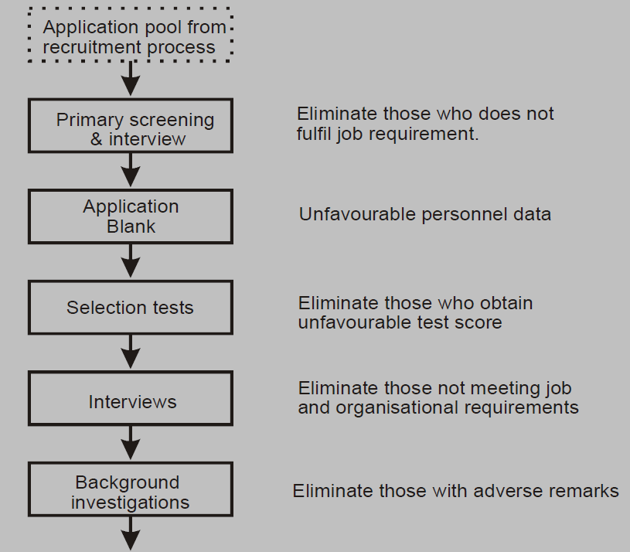
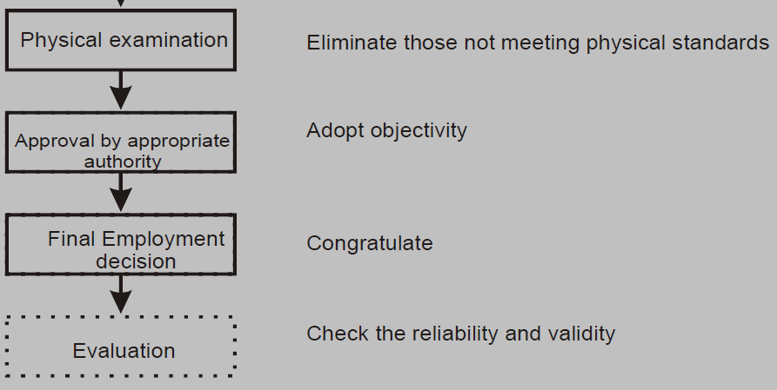
Steps involved in Selection

Slide 70
1.Application pool -maximum number of applications for the selection process
2. Preliminary Screening and Interview: to sort the qualified persons
3. Application Blank or Application Form: to get information from a prospective applicant which will enable the management to make a proper selection.
(a) Biographical Data:, (b) Educational Attainment, (c) Work Experience: (d) Salary and Benefits (e) Other Items:
4. Selection Tests: Aptitude, Personality, Interest, Performance, Knowledge, Intelligence, Achievement, Projective
5. Interview: to get information from a person and to assess his potential for the job

Slide 71
Objectives of Interviews: Interview helps:
To obtain additional information from the candidate.
Facilitates giving to the candidate information about the job, company, its policies, products etc.
To assess the basic suitability of the candidate.
Types of interviews: Interviews can be classified in various ways according to:
(A) Degree of Structure (B) Purpose of Interview (C) Content of Interview
(A) Degree of Structure:
(1) Unstructured or non directive: in which you ask questions as they come to mind. There is no set format to follow.
(2) Structured or directive: in which the questions and acceptable responses are specified in advance. The responses are rated for appropriateness of content.

Slide 72
(B) Purpose of Interview: A selection interview is a type of interview designed to predict future job performance, on the basis of applicant’s responses to the oral questions asked to him.
A stress interview is a special type of selection interview in which the applicant is made uncomfortable by series of awkward and rude questions.
The aim of stress interview is supposedly to identify applicant’s low or high stress tolerance.
In such an interview the applicant is made uncomfortable by throwing him on the defensive by series of frank and often discourteous questions by the interviewer.

Slide 73
6. Background Investigation: Using external or internal agencies,
7. Physical Examinations: Physically fitness
8. Approval by Appropriate Authority:suitable candidates are recommended for selection by the selection committee or personnel department
9. Final Employment Decision: After a candidate is finally selected, the human resource department recommends his name for employment. The management or board of the company offers employment in the form of an appointment letter mentioning the post
10. Evaluation-A period audit, conducted by people who work independently of the human resource department, will evaluate the effectiveness of the selection process

Slide 74
Training
1. Improves Morale of Employees- job security and job satisfaction.
2. Less Supervision- well acquainted with the job and will need less of supervision.
3. Fewer Accidents- the less are the chances of committing accidents in job and the more proficient the employee becomes.
4. Chances of Promotion- develops skills and efficiency.
5. Increased Productivity- improves efficiency and productivity

Slide 75
Types of training
On the job and off the job training
On the job training
takes place in a normal working situation
as most effective for vocational work.
It is done on ad-hoc manner with no formal procedure, or content
At the start of training, or during the training, no specific goals or objectives are developed
Trainers usually have no formal qualification or training experience for training
Training is not carefully planned or prepared
The trainer are selected on the basis of technical expertise or area knowledge

Slide 76
The four techniques for on the job development are:
1.) Coaching - a corrective method for inadequate performance.
Procedure of the Coaching
1. Understand the participant’s job, the knowledge, skills, and attitudes, and resources required to meet the desired expectation
2. Meet the participant and mutually agree on the objective that has to be achieved
3. Mutually arrive at a plan and schedule
4. At the job, show the participant how to achieve the objectives, observe the performance and then provide feedback
5. Repeat step 4 until performance improves
For the people at middle level management, coaching is more likely done by the supervisor; however experts from outside the organization are at times used for up and coming managers.
Personalized approach assists the manger focus on definite needs and improvement.

Slide 77
2. mentoring:
an ongoing relationship that is developed between a senior and junior employee
guidance and clear understanding of how the organization goes to achieve its vision and mission
Non structured meeting and performed by some one from inside of company (Executive mentoring)
It helps the executives to grow professionally by developing management skills and learning how to work with people with diverse background, culture, and language and personality types
It allows the mentor to determine what is required to improve mentee’s performance.

Slide 78
Some key points on Mentoring
Mentoring focus on attitude development
Conducted for management-level employees
Mentoring is done by someone inside the company
It is one-to-one interaction
It helps in identifying weaknesses and focus on the area that needs improvement
Job rotation
Learning how the organization is perceived from the outside broadens the executive’s outlook on the process of the organization.
the rotation might be to a foreign office to provide a global perspective.
For managers being developed for executive roles, rotation to different functions in the company is regular carried out.

Slide 79
A recent study indicated that the single most significant factor that leads to leader’s achievement was the variety of experiences in different departments, business units, cities, and countries
Some of the major benefits of job rotation are:
It provides the employees with opportunities to broaden the horizon of knowledge, skills, and
abilities by working in different departments, business units, functions, and countries
Identification of Knowledge, skills, and attitudes (KSAs) required
It determines the areas where improvement is required
Assessment of the employees who have the potential and caliber for filling the position

Slide 80
Job Instruction Technique (JIT
uses a strategy with focus on knowledge (factual and procedural), skills and attitudes development.
JIT Consists of Four Steps:
Plan –a written breakdown of the work
to be done
the trainer and the trainee must
understand that documentation is a must
and important for familiarity
of work.
what the trainee knows and what training
should focus on
proper orientation program, availing the resources, familiarizing trainee with the training program, etc

Slide 81
Present: Trainee actually demonstrates the procedure while emphasizing the key points and safety instructions
Trial: rehearsal step; improving the method of instruction; questioning and guiding to identify the correct procedure
Follow-up: to prevent bad work habits from developing; Cognitive and behavioural methods;

Slide 82
On the job training method has the following advantages that can be considered:
Generally most cost-effective
Employees are actually productive
Opportunity to learn whilst doing
Training alongside real colleagues.
Training can be delivered on time and at the optimum time.
The trainee will have the good opportunities to practice and implement.
The trainee will have feedbacks.
Trainee builds confidence by working with own speed and productivity.

Slide 83
Off-the job training
many management development techniques that an employee can take in off the job
1.) Sensitivity Training
is about making people understand about themselves and others reasonably, which is done by developing in them social sensitivity and behavioral flexibility.
Social sensitivity in one word is empathy.
Behavioral flexibility is ability to behave suitably in light of understanding.
Steps in Sensitivity training

Slide 84
Unfreezing the Old Values –
aware of the inadequacy of the old values where old values are not able to provide proper guidance
Development of New Values –
With the trainer’s support, trainees begin to examine their interpersonal behavior and giving each other feedback.
The reasoning of the feedbacks are discussed which motivates trainees to experiment with range of new behaviors and values.
This process constitutes the second step in the change process of the development of these values.
Refreezing the new ones –
This step depends upon how much opportunity the trainees get to practice their new behaviors and values at their work place.

Slide 85
2) Transactional Analysis:
a realistic and useful method for analyzing and understanding the behavior of others
The motivation reaction relationship between two persons is a transaction
Transactional analysis can be done by the ego states of an individual

Slide 86
Child:It is a collection of recordings in the brain of an individual of behaviors, attitudes, and impulses which come to her naturally from her own understanding as a child
The characteristics of this ego are to be spontaneous, intense, unconfident, reliant, probing, anxious, etc
“I guess”, “I suppose”, etc. and non verbal clues like, giggling, coyness, silent, attention seeking etc.
Parent: It is a collection of recordings in the brain of an individual of behaviors, attitudes, and impulses imposed on her in her childhood from various sources such as, social, parents, friends, etc
The characteristics of this ego are to be overprotective, isolated, rigid, bossy
Verbal clues that a person is operating from its parent states are the use of words like, always, should, never, etc and non-verbal clues such as, raising eyebrows, pointing an accusing finger at somebody, etc.
Adult: It is a collection of reality testing, rational behavior, decision making, etc.
A person in this ego state verifies, updates the data which she has received from the other two states.
It is a shift from the taught and felt concepts to tested concepts.
All of us evoke behavior from one ego state which is responded to by the other person from any of these three states.

Slide 87
3.) Lecture: Lecture is given to enhance the knowledge of listener or to give him the theoretical aspect of a topic
It may be interactive or non interactive.
Straight lecture method consists of presenting information it does not involve any kind of interaction between the trainer and the trainees
A good lecture consists of introduction of the topic, purpose of the lecture, and priorities and preferences of the order in which the topic will be covered.
4.) Games and Simulations are structured and sometimes unstructured, that are usually played for enjoyment sometimes are used for training purposes as an educational tool.
Training games and simulations are different from work as they are designed to reproduce or simulate events, circumstances, processes that take place in trainees’ job
A Training Game is defined as spirited activity or exercise in which trainees compete with each other according to the defined set of rules.

Slide 88
Simulation is creating computer versions of real-life games. Simulation is about imitating or making judgment or opining how events might occur in a real situation.
It can entail intricate numerical modeling, role playing without the support of technology, or combinations.

Slide 89
The various methods that come under Games and Simulations are:
BEHAVIOR-MODELLING
BUSINESS GAMES
CASE STUDIES
EQUIPMENT STIMULATORS
IN-BASKET TECHNIQUE
ROLE PLAYS

Slide 90
Wages and Salary administration
Employees’ compensation is one of the major determinants of employee satisfaction
The compensation policy and the reward system of an organization are viewed by the employee as a indicators of the management’s attitude and concern for them
employees moral, motivation, productivity and their relationship with the management more or less associated with the compensation management system
Job evaluation helps to determine the relative worth of job in an organization in a systematic, consistent and accurate manner.
The basic wage, incentives and rewards and benefits, together from compensation package of an employee

Slide 91
Principles of Wage and Salary Administration
should be develop and maintain based on sound principles
1) maintaining equity in the distribution of wages and salaries in the organization (Plan and system)
2) Maintaining competitiveness in the wage market (the general level of wage and salary should be reasonably in line with that prevailing in the market)
3) Matching employees’ expectations and it should avoid unjustified discrimination.
4) differences in the compensation package should be based on contribution, productivity, job performance, achievement etc.
5) Devising a system that is the most efficient for the organization, as far as possible it must eliminate any discrepancies or exploitation of the employees.
6) The compensation system should formulate and define rules and regulations for determining, changing, adjusting wages in the organization.

Slide 92
7) It must ensure fairness, should maintain harmonious relationship
8) Compensation system should be flexible enough so that future changes can be incorporated.
9) The wage and salary administration should take care of and comply all the rules and regulations laid down by the legislator for protecting the employees’ interest.
10) Optimization of management and employee interests.

Slide 93
Essentials of Sound Wage and Salary Administration
the pre requisites for the sound compensation system are
Rational Job Analysis:
It reveals detailed aspects of the job, like duties, responsibilities associated with the performance,
It gives performance standards as a fair parameter for evaluation of the performance.
It gives fair idea about job specification i.e. qualification, experience, skill and other essential requirements that job performer must satisfy.
Thus rational job analysis always put policy decider in a better condition to lay down appropriate content in policy design.

Slide 94
2. Proper Job Evaluation:
Job evaluation is a systematic process of analyzing and evaluating jobs to determine the relative worth of job in an organization.
It forms the basis for designing the sound compensation system in an organization.
the perceived fairness of approach adopted under wages and salary administration have a immense influence on employee morale, motivation and satisfaction,
proper job evaluation exercise demands sensible consideration

Slide 95
3. In Depth Knowledge About an Organization and Market Factors:
the size and structure of the organization
the industry in which it operates,
the strength of employees union,
position of a person and his importance to the organization,
demand and supply for particular skill sets in the industry,
organizational ability
capacity to pay and its economic condition like profitability,
legislative aspects related with wage determination

Slide 96
4. Clarity of Objectives or Purposes of Wage and Salary Administration
clarity about the purposes that it may tries to satisfy through policy decisions
attracting talented resources;
retaining and motivating employees;
financial management of an organization;
satisfying legal requirement;

Slide 97
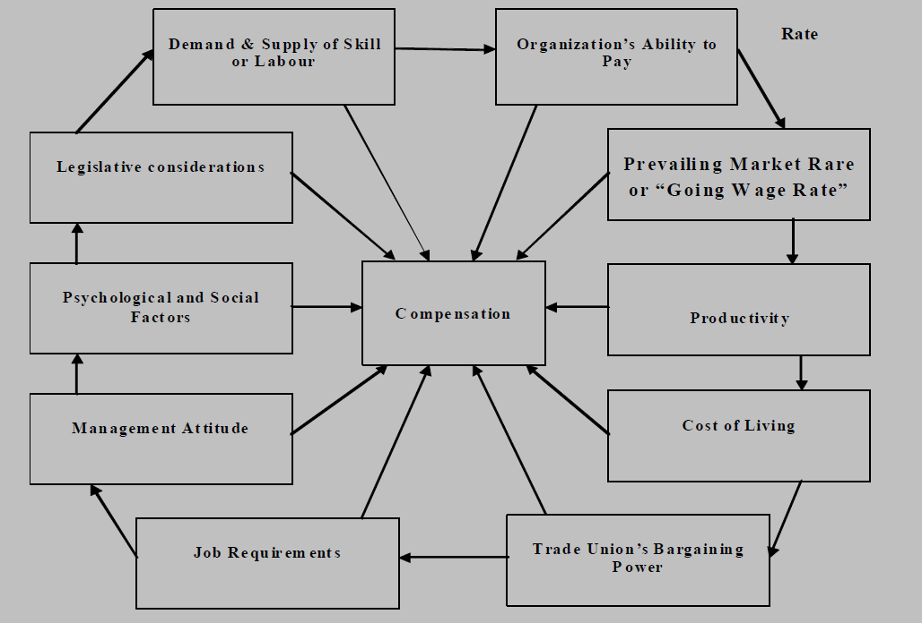
Factors affecting Wage and Salary Administration

Slide 98
1. Demand and Supply:
If there is a shortage of labor, the wages demanded will be high.
If, on the other hand labor is plentiful, workers will be too willing to work at low rates of wages.
An employee will not hesitate to accept lower wages if he has opportunities for growth in the organization
2. Organization’s Ability to Pay:
Financial position and soundness
Good compensation package helps in attracting and retaining quality talent in an organization
3. Prevailing Market Rate or “Going Wage Rate”: (‘most comparable rate of wage’,)
competition and a practice of ‘Brain Drain’ prevails in the market.
certain laws framed laid down principal of’ minimum wages’, ‘equal wage for equal work’

Slide 99
4) Productivity:
Productivity is measured in terms of output per man hour.
technology, labor efforts, method of doing work, management contribution and support.
base for wage differences since it a base which is apparently justifiable and acceptable to all in the organization.
a discretion of management policies.
5) Cost of Living:
It is always expected that there has to be adjustment in pay rates in accordance with prevailing cost of living.
Base of collective bargainning on wage issues.
6) Trade Union’s Bargaining Power:
collective bargaining or negotiation,
collective bargaining and negotiations depends upon the trade union’s strength.
The strength and power of the trade union depends upon its membership, financial strength and leadership it may have, for

Slide 100
7) Job Requirements:
appropriate job analysis and job evaluation exercise is a base for the wage determination and revision.
wages to be paid to the workers should be in accordance with the duties, responsibilities and the efforts likely to be put for job performance.
Wage or compensation package very in accordance with job description and job specification.
8) Management Attitude:
Attitude of employer or management towers the working community of the organization
Some reputed and professional organization does prefer to pay wage in accordance with their reputation or prestige of an organization in the market.
They may give participation to workers in sharing profits.
On the other hand conservative organizations do not prefer to go for such profit sharing.

Slide 101
9) Psychological and Social Factors:
Psychologically person perceive wages and compensation package as sole parameter for success or failure in the life.
Compensation package plays significant role in the employees pride, moral, motivation and psychological engagement and involvement in the work.
wage should be in accordance with efforts and workers should not be felt like being cheated.
Compensation policy should not make any discrimination and must try to satisfy condition for fairness equity and justice.
10) Legislative Considerations:
Legislative provisions do provide protection to the working community by fixing bottom line for wage payments.
the bargaining power of the workers was not strong enough to ensure fair wages.
Legislation like Minimum Wages Act, 1936, provides for statutory minimum wages

Slide 102
Methods of Wage Payments
It should be simple and understandable
It should be capable of easy computation
It should be capable of motivating the employees
It should be attractive enough for new talent in the organization.
It should be fair, just and stable to all the employees.

Slide 103
Time Rate Wage System
workers are paid according to the work done during a certain period of time at a rate of per hour, per day, per week, per fortnight, or per month or any other fixed period of time
According to the section4 of the Payments of Wages Act,1936, not more than one month must elapse between two wage period
adopts time as the basis of worker remuneration without taking in to account the units produced.

Slide 104
Merits:
It is simple and understandable and easy for calculation of wages
There is no time limit for completion of job, workman are not in hurry to finish it and this may mean that they may pay p enough attention to the quality of work, effective handling of machinery and utilization of resources in an optimum manner.
All workers are given same treatment in terms of equal wage payment, so grievances, ill will; jealousy can be avoided among them.
Time rate system provides regular and stable income to workers, so they can adjust and manage their budget accordingly.
It requires less administrative attention as this system provide good faith and mutual understanding and trust between employer and employee.

Slide 105
Demerits:
It does not take in to account the ability and capacity of the workers so the skilful and more capable workers who have higher production efficiency will demoralize.
Time rate system is unrelated to the productivity and does not provide extra motivation for extra efforts by the workers.
The labor charges for a particular job do not remain constant.
There is a possibility of systematic evasion of work by the workers, since there is no specific target or demand for specific quantity of work by the management.
Time rate system does not ask for maintaining individual workers record, it becomes difficult for the employer to determine his relative efficiency for the purpose of performance evaluation for future promotion or rewards. So it does injustice to the outstanding employees.

Slide 106
Suitability:
Time rate system is suitable when the output contributed by the worker is difficult to measure and cannot be recorded in an individual basis.
It is also suitable when by cultivating mutual trust and confidence and by giving fair and equal treatment to all the employees, management can get the work done in an appropriate manner

Slide 107
Piece Rate Wage System:
workers are paid according to the amount of work done or numbers of units produced or completed, the rate of each unit being settled in advance, irrespective of the time taken to do the work
indirect implication that a worker should not take more than average time
Merits:
recognition of merit, more equitable then time rate system.
it gives direct stimulus and motivation to the employees for extra efforts, which may result into more productivity.
less managerial supervision as total remuneration depends upon units produced, and not on time spent in an organization.
a workman is likely to take greater care to prevent breakdown in the machinery or in the work shop.
it reduces maintenance expenditure in an organization.

Slide 108
As the direct labor cost per unit of production remains fixed and constant, calculation of cost while filling tenders and estimates becomes easier.
It results in to not only increase in the output and wages ,but the methods of production too are also improved, as workers demand material and tools free from defects and machinery in perfect operating condition.
Demerits:
If rates of wages are not scientifically fixed and acceptable to the workers, would result into workers exploitation and may prove counterproductive
As workers are interested in completion of the job with a greatest speed, may damage the machinery, quality of output or may increase rate of hazards in an organization.
Trade unions generally do not like this system of wage payment; they may not have full support and acceptance. It may be the major issue for industrial dispute.

Slide 109
Suitability:
It can be introduced generally in jobs of a repetitive nature, when task can be easily measured, inspected and counted.
It is practically suitable for standardized processes, and it appeals to skilled and efficient workers who can increase their earnings by working to their best capacity.

Slide 110
Balance and Debt System
Combination of time rate and Piece rate
a minimum weekly wage is guaranteed for a full weeks’ work with an alternative piece-rate determined by the rate fixed on the assumption that the worker would put enough effort to earn his minimum wage.
If the wages calculated on piece bases are in excess of the time rate, the worker earns the excess.
If the piece rate wages are less than the time-rate earnings, he would still get weekly wage, but on the condition that he shall have to make good the excess paid to him out of the subsequent wage he would earn
it a hybrid system producing the same benefits and limitations of both the time rate and piece rare system

Slide 111
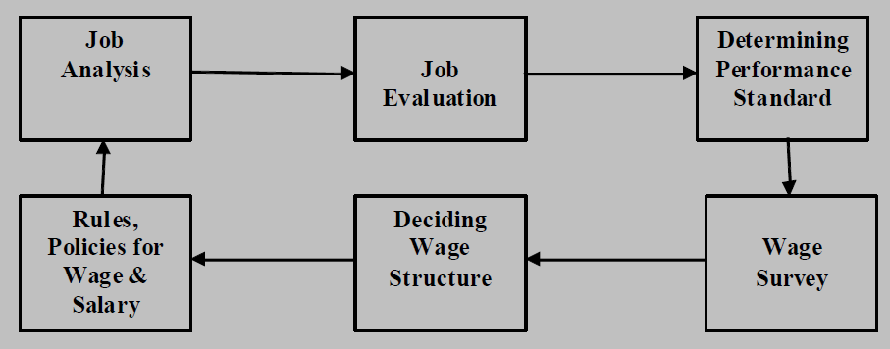
Process of Wage Determination
it depends upon sole discretion that what procedure an organization follows for wage and salary administration.
More or less an attempt is made by every organization to follow the principles suggested for sound compensation management
Process of wage determination includes job analysis and job evaluation, survey of wages in the environment, determining wage structure, and deciding rules for wage administration.

Slide 112
Job Analysis and Job Evaluation:
Job analysis reveals information about tasks, duties, responsibilities and standards with proposed job is to be performed by the employees.
It also guides in terms of job specification i.e. skills, ability, qualification and experiences needed to perform the job with requisite performance standards.
Job evaluation is nothing but finding out relative worth of a job, in terms its contribution and significance to the overall organizational objectives.
Determining Performance Standard and Wage Surveys:
After job analysis and evaluation
an organization must survey wage rates prevails in the market for the same job or its similar type, so that attractive compensation package can be designed to induce good quality of candidature to apply for the job in an organization.
Here care should be taken that wage structure should be in accordance with the complexity and efforts needed in the performance.

Slide 113
Deciding Wage Structure and Rules for Its Administration:
Based on collection of relevant information and taking in to account some of the influencing factors, an organization should design wage structure which includes slab for basic or minimum wages, incentives, and/or increment over a period of time to gather with other financial and nonfinancial perquisites to be offered to an employee.
Attempt should be made to follow principles of fairness, equity and justice to gather with transparency while designing wage structure and deciding rules for its administration.
The rules should not provoke unjustified discriminations and exploitation of workers otherwise it may prove counterproductive and may give rise to grievance, and industrial disputes.

